Slide 1
Codebook sample (one variable out of the 5 I use in this analysis)

Slide 2
Hypothesis: There is a non-zero correlation between year and happiness reports.
Finding: There is a NOT a non-zero correlation.
I fail to reject the null hypothesis.

Slide 3
Hypothesis: There is a statistically significant difference in the mean of happiness from 2018 compared with 1972.
Finding: There is NOT a statistically significant difference.
I fail to reject the null hypothesis.
T-Test of 1972 Happiness vs. 2018 Happiness
P-value = .39

Slide 4
Hypothesis: When controlling for other factors such as age and education, year will be a statistically significant predictor of happiness
Finding: While the results are staitsitically significant, the model has almost no explanatory power, and therefore, it appears that year is not a strong predictor.
I fail to reject the null hypothesis.
Call:
lm(formula = gss$happy ~ gss$year + gss$age + gss$bach + gss$lths)
Residuals:
Min 1Q Median 3Q Max
-1.3767 -0.2455 -0.1469 0.7189 0.9976
Coefficients:
Estimate Std. Error t value Pr(>|t|)
(Intercept) 3.2655792 0.6560803 4.977 6.50e-07 ***
gss$year -0.0015797 0.0003291 -4.800 1.60e-06 ***
gss$age 0.0012732 0.0002618 4.864 1.16e-06 ***
gss$bach 0.1320671 0.0114133 11.571 < 2e-16 ***
gss$lths -0.0995965 0.0120913 -8.237 < 2e-16 ***
---
Signif. codes: 0 ‘***’ 0.001 ‘**’ 0.01 ‘*’ 0.05 ‘.’ 0.1 ‘ ’ 1
Residual standard error: 0.6325 on 19407 degrees of freedom
Multiple R-squared: 0.01399, Adjusted R-squared: 0.01379!!!!!!
F-statistic: 68.86 on 4 and 19407 DF, p-value: < 2.2e-16

Slide 5
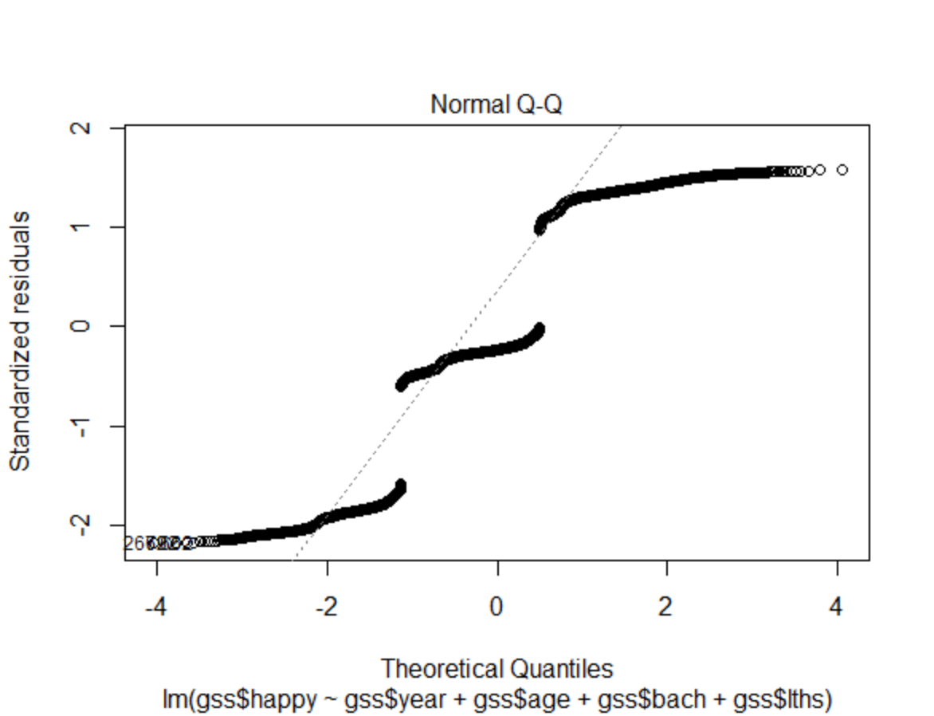
A linear regression model on happiness reports produces patterns of residuals that depart significantly from a normal distribution, suggesting the model has excluded important variables.

Slide 6
Plain language summary of results:
By several measures, we find no statistically or analytically important relationship between the year of the survey and happiness levels.

